Slide 1

Project 4: Hiring Process Analytics
First we will deal with data cleaning process.
We will find missing values in data and we will replace it with – or mean, median mode.
Then we will perform our tasks.

Slide 2
A) Task- Hiring analysis: Gender distribution of hiring.
We will make bar chart to find gender distribution in company.
This bar chart shows the desired results
1856 Females were hired and
819 were rejected.
Where as 2563 males are hired
And 1522 were rejected.

Slide 3

B)Task: Salary Analysis: calculating average salary.
We will calculate average salary by following formula:
Average salary : = AVERAGE(G2:G7169)
= 49983.
The average salary is 49983.

Slide 4
C)Task: Salary Distribution: to calculate salary class interval
We will calculate average salary of different departments. Then will compare salary of these departments.
General management class has highest
Average salary.

Slide 5
D)Departmental Analysis: use chart to visualise proportion of people working in different departments. Result: operational department has most number of employees.

Slide 6
E)Position Tier Analysis: these are different position tiers with different departments.

Slide 7
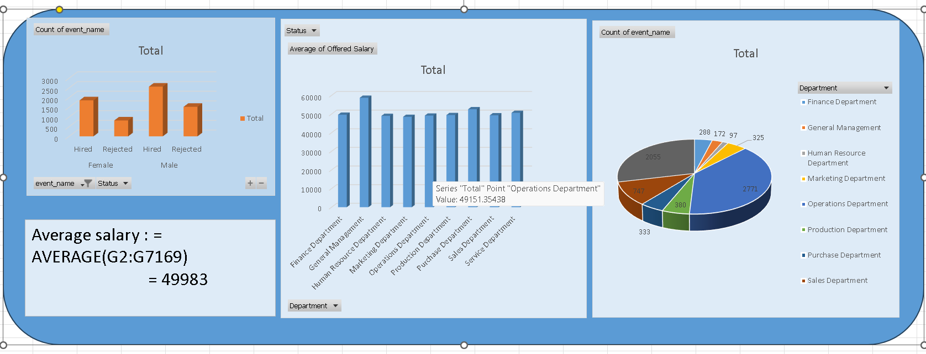
Dashboard view: I have created dashboard so that all the result can be seen at one place. Hyperlink = Click Here

